Slide 1
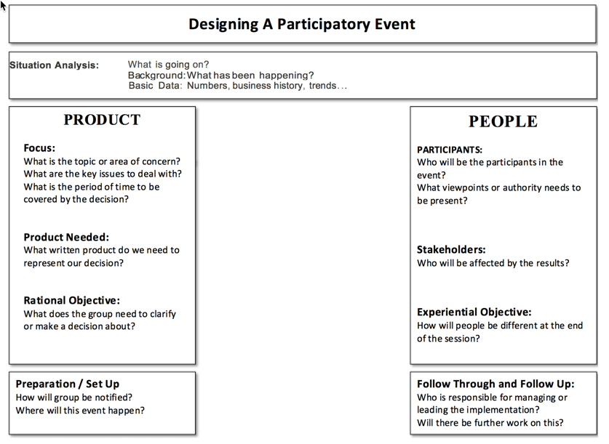
Preparing for an Event
PROCESS (Before Meeting)
Design | Space | Yourself
Focus the topic by finding a place to begin Write down Rational Aim (RA) and Experiential Aim (EA) of the conversation Ensure a concrete beginning point for your objective questions Brainstorm questions that achieve the RA/EA Select and order the questions you will ask (minimum 1 per level, more if needed) Determine time for each question Prepare your opening and closing carefully | Secure an appropriate space for the meeting design and attendance Configure seating so people can interact with each other easily and see documentation Have the space fully set up in advance. (This may require a site visit for unfamiliar spaces) Display data / relevant information in a manner that is easy to access and use Post initial charts. Agenda (and ground rules) should always be visible in front Consider specialty decor (toys help kinesthetic participants stay engaged) Place participant supplies at seats (name cards, markers, half-sheets, pencils, copies of prior notes, agenda) | Rehearse the conversation in your head Visualize yourself in the room facilitating the conversation successfully Calm and center yourself before the meeting starts. Be in a good frame of mind Write out all needed charts before the meeting starts: Purpose Agenda Instructions Charts with any questions whose answers will be documented. Arrange charts in order they will be used
California SNAP-Ed ToP Facilitation Virtual Mentoring Project

Slide 2
Preparing for an Event
During the Event Invite participants to get settled Share meeting purpose and agenda The first questions - go round robin with introductions and relevant first question. Ask subsequent questions - popcorn style according to the design. Keep conversation moving to avoid getting bogged or off track. Hold a reflective conversation about the session (ORID, +/r). Close the meeting with clear statement of next steps, assignments and appreciations. | Follow up Reflect on the conversation, the group and yourself (refer back to the reflection tool learned last time) Learn from the experience Document the meeting - at least decisions and next steps Distribute notes ASAP - so everyone knows their assignments and follow up activities Facilitator checks in with individual assignments and provides support as needed. Hold periodic check-ins to make sure everyone is on track between meetings
California SNAP-Ed ToP Facilitation Virtual Mentoring Project

